Slide 1
ENSE 470 - Milestone 1
Group Name: GGWP
Group Members:
Vincent Chan
Thiago De Melo
Shuaihao Zhao
Joe Emmanuel Samano
January 18, 2018

Slide 2
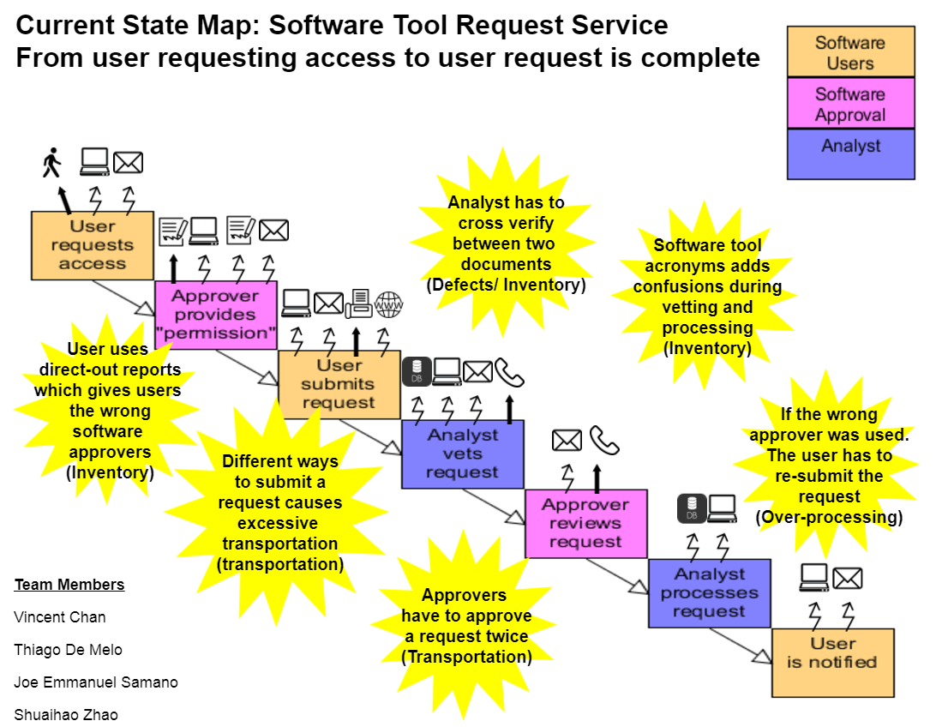

Slide 3
Group Reflection
How did you feel about this milestone? What did you like about it? What did you dislike?
[Response here]
What did you learn about yourself as you collaborated and worked through this milestone?
[Response here]
How will you use what you have learned going forward?
[Response here]
What “stuff & things” related to this milestone would you want help with?
[Response here]

